Slide 1
Activity Recognition Using
E-Textile Sensors
Hakan ERÖZTEKİN
Computer Engineering Department,
Istanbul Technical University
eroztekin@itu.edu.tr

Slide 2
MOTIVATION
Propose a solution for recognition of different activities via data collected from e-textile sensors and using machine learning models
Build a scalable basis for the future work such as recognition of dozens of movements via smart clothing with more than two sensors

Slide 3
LITERATURE REVIEW
LSTM-Based Early Recognition of Motion Patterns (Markus Weber et al., 2014)
96% accuracy of 5 actions with low-cost sensors
Early detection of livestock diseases (Eduardo Fernández-Carrión et al., 2017)
3-class classification of animals’ movements and 95% confidence on detection disease animals
Space Object Detection in Video Satellite Images Using Motion Information (Xueyang Zhang, Junhua Xiang, Yulin Zhang, 2017)
Movement detection using brightness change and thresholding

Slide 4
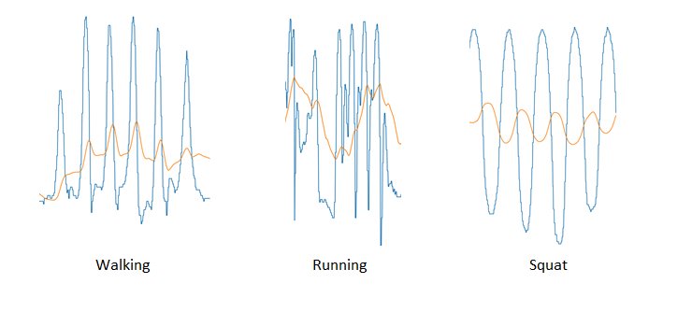
INTRODUCTION
Recognition of different activities is a problem of multiple areas
Smart clothing applications, aerospace engineering, disease detection at livestocks...
Each activity has its unique characteristics

Slide 5
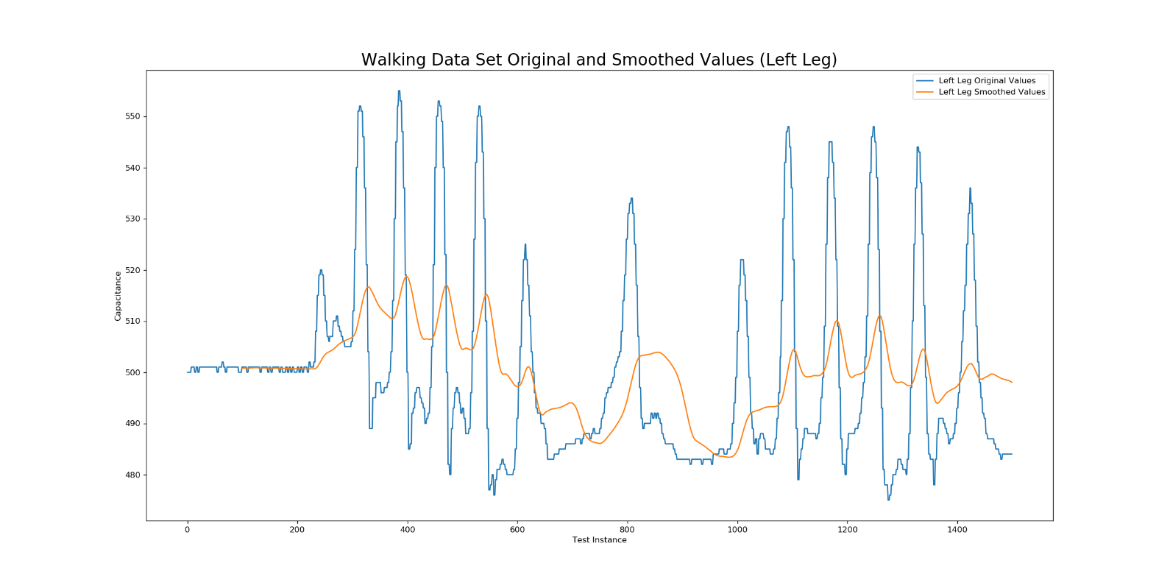
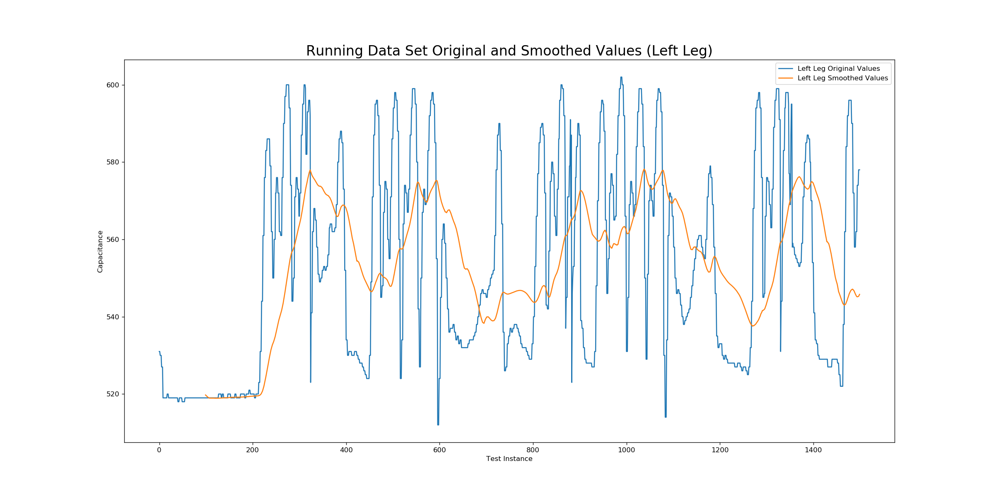
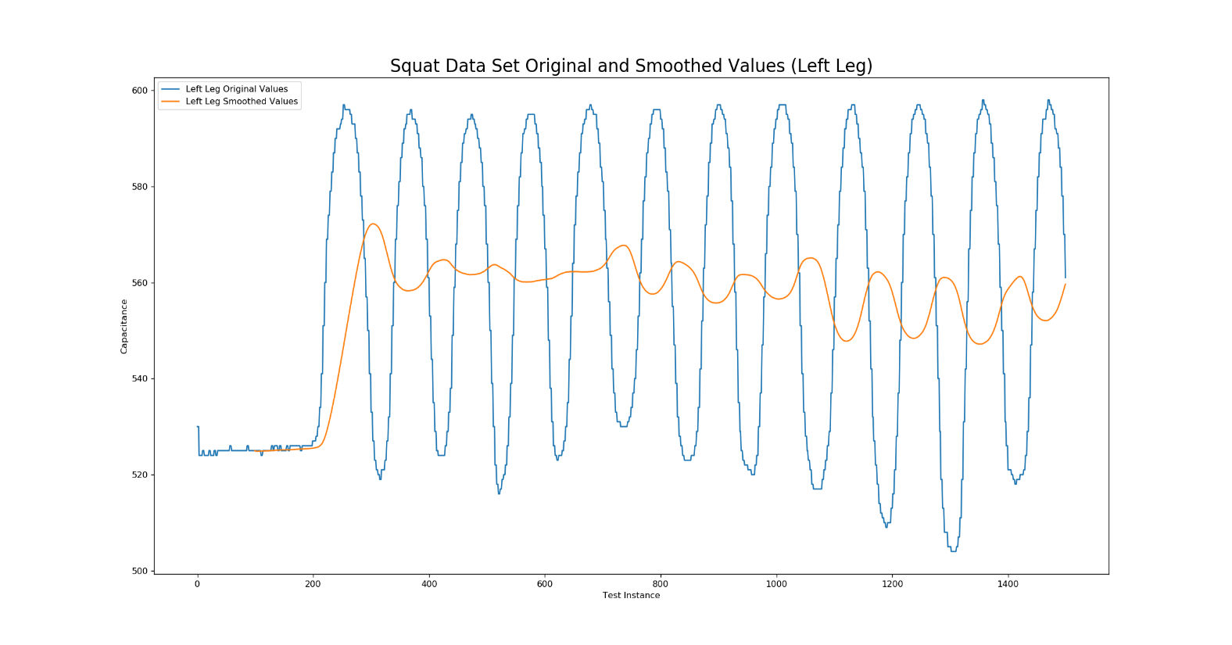
BACKGROUND
Activity recognition methodology should be selected for the problem type.
Movement, running and squats have different patterns which aids the recognition.
Walking Movement Pattern
Running Movement Pattern
Squat Movement Pattern

Slide 6
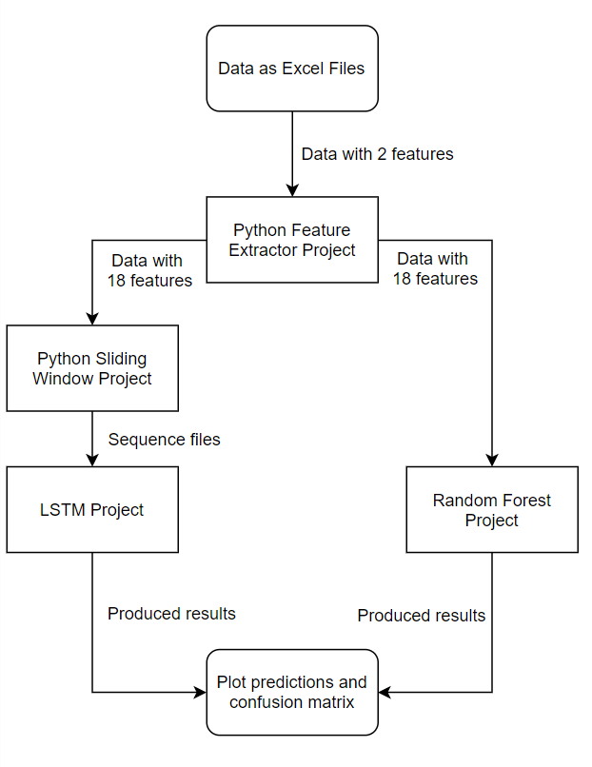
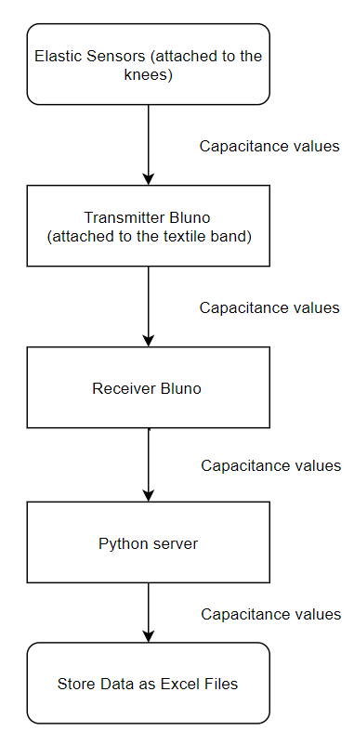
PROPOSED ACTIVITY RECOGNITION SYSTEM

Slide 7
PROPOSED ACTIVITY RECOGNITION SYSTEM
Data Collection
Using e-textile sensors to measure the capacitance values
Transmission of the measurement via Blunos
Saving the data in an appropriate format for later usage

Slide 8
PROPOSED ACTIVITY RECOGNITION SYSTEM
Data Preprocessing
The unexpected values are removed from the data which is probably caused by the Python server during the data collection

Slide 9
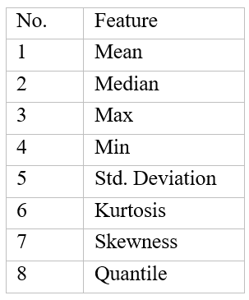
PROPOSED ACTIVITY RECOGNITION SYSTEM
Feature Extraction
Using data with 2 features (left and right leg capacitances), 8 more feature is extracted for each leg using rolling window approach
Extracted features

Slide 10
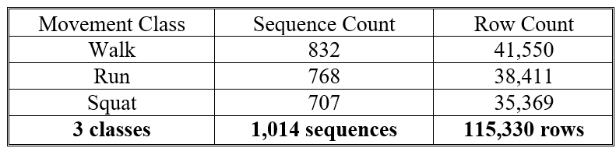
PROPOSED ACTIVITY RECOGNITION SYSTEM
Feature Extraction
For the Long Short Term Memory(LSTM) model, sliding window approach is executed. 2-second of measurement (approximately 100 rows of data) and 50% overlapping is determined as the configuration.
Data overview

Slide 11
PROPOSED ACTIVITY RECOGNITION SYSTEM
Data Preprocessing
For LSTM, sliding window approach is executed. 2-second of measurement (approximately 100 rows of data) and 50% overlapping is determined as the configuration.

Slide 12
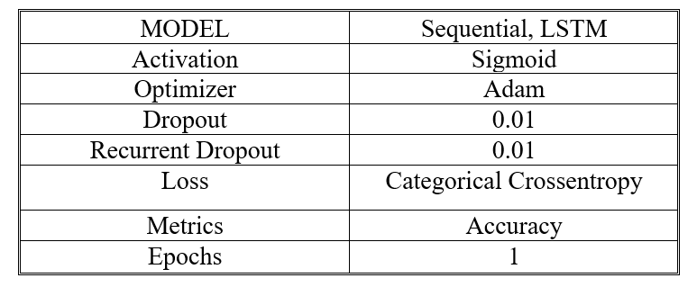
PROPOSED ACTIVITY RECOGNITION SYSTEM
Model Training
Using the configuration provided below, LSTM model is trained.
LSTM configuration

Slide 13
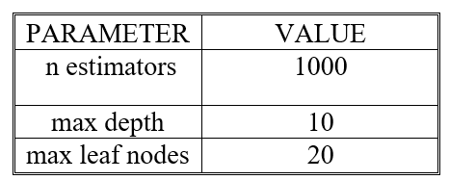
PROPOSED ACTIVITY RECOGNITION SYSTEM
Model Training
Also, using the data with the extracted features, random forest algorithm is trained.
Max depth and max leaf nodes are specified to prevent possible overfitting.
Random Forest configuration

Slide 14
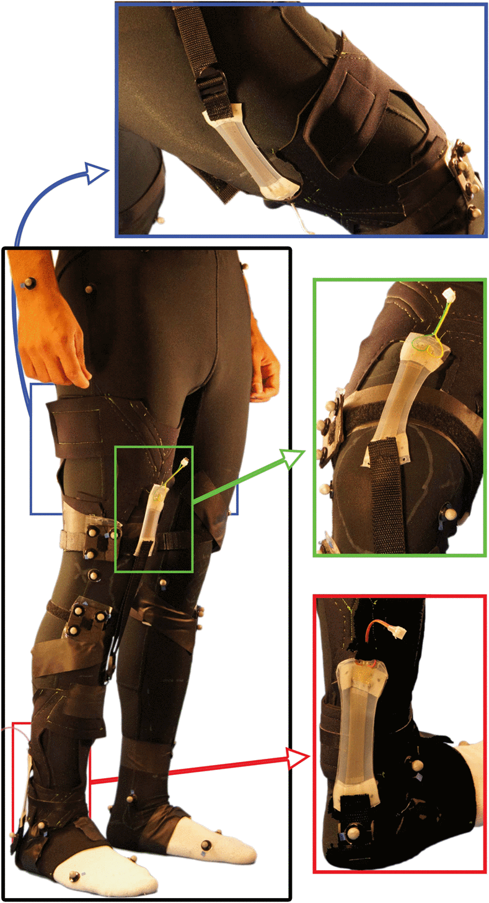
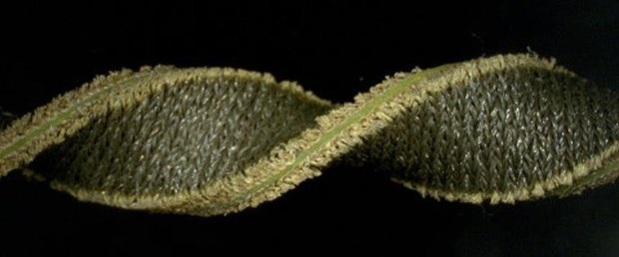
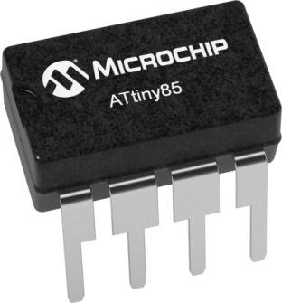
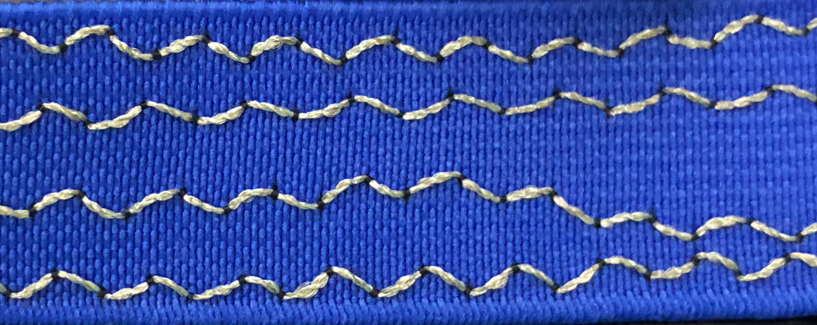
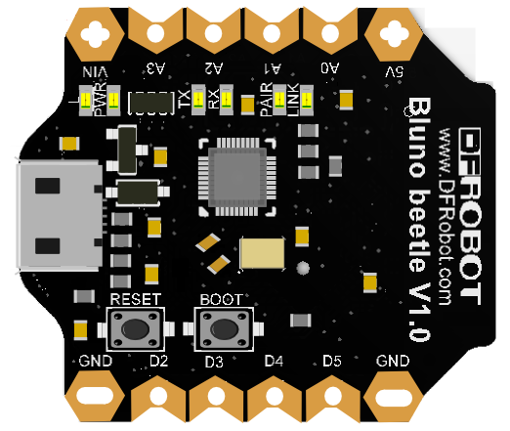
EXPERIMENTS
Hardware Specification:
2 Blunos attached to the e-textile sensors

Slide 15
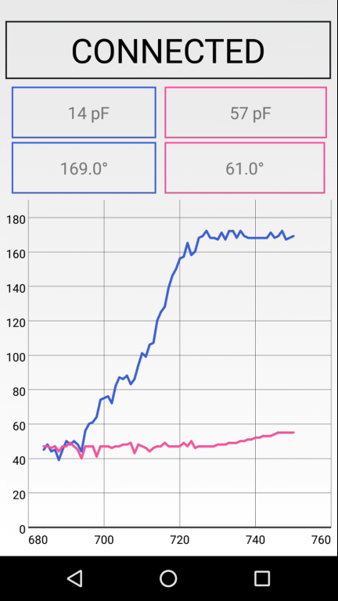
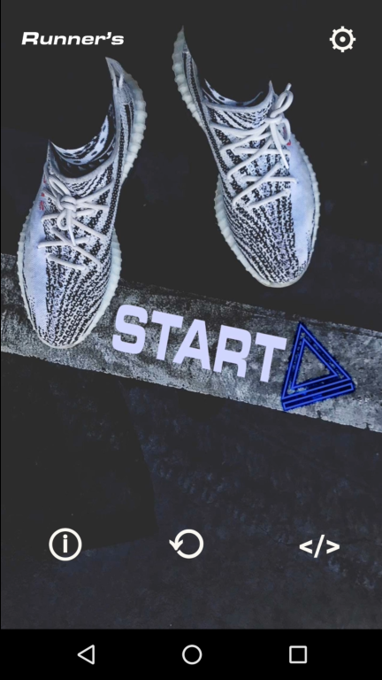
EXPERIMENTS
Software
Specification:
Arduino IDE
Python 3.7
PyCharm IDE
Brackets
Anaconda Prompt
Used packages: numpy, pandas, sklearn, matplotlib, tensorflow, keras

Slide 16
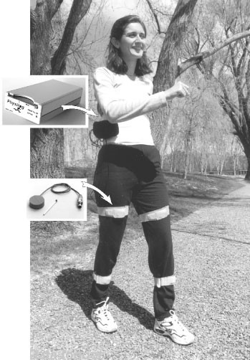
EXPERIMENT CONDITIONS
Acquired data
From 3 healthy adults (ages between 24-27)
5 minutes of measurement for each movement (walking, running, squats)

Slide 17
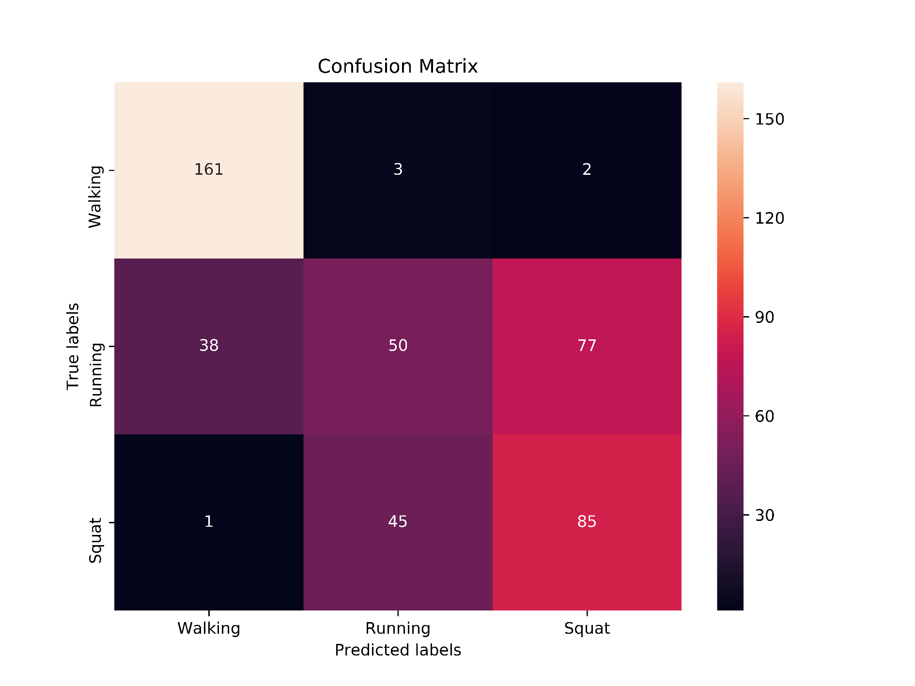
RESULTS
LSTM
Accuracy: 64%
Confusion matrix

Slide 18
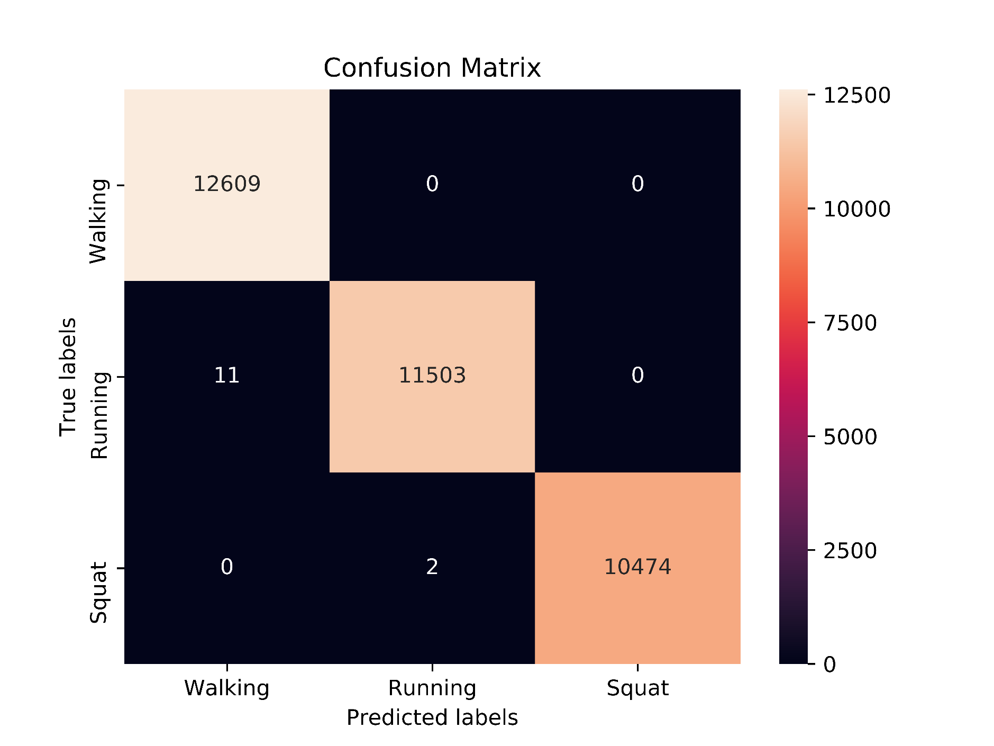
RESULTS
Random Forest
Accuracy: 95%
Confusion matrix

Slide 19
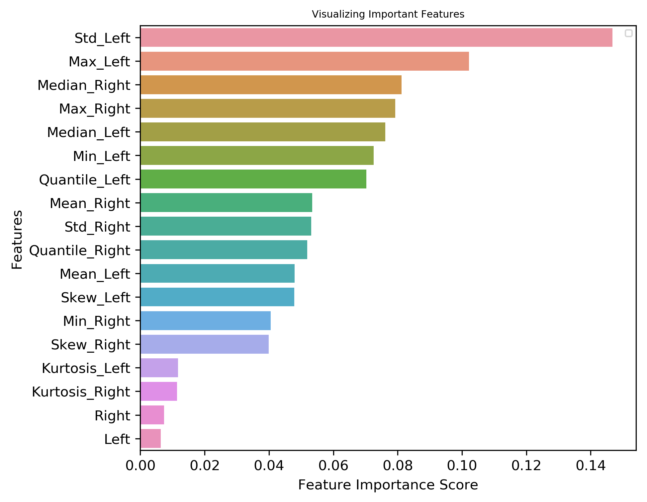
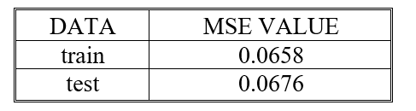
RESULTS
Random Forest
Feature importance and error values
Mean Squared
Error values

Slide 20
CONCLUSION
Data collection via e-textile sensors and Blunos and 3-class activity recognition on the data are exercised
64% accuracy with LSTM
95% accuracy with Random Forest
A method to activity recognition proposed
cost effective
scalable basis for multiple activity recognition with multiple sensors
Future work;
Detection of heart-rate anomalies in real time for the people with heart diseases to inform nearest ambulance
Providing accurate health metrics for people who go to gym regularly
Detection of abnormal positions/standings in the elderly people who live alone to inform the related person and/or the hospital

Slide 21
Thank you
Contact:
eroztekin@itu.edu.tr

